Slide 1

PITCH DECK
Presented by Rosa Maria Aguado

Slide 2

WHAT’S IN IT FOR YOU
₱40B (8–10% CAGR)
Philippine specialty coffee industry
Gen Z & Millennials = 75% of café spenders nationwide
Experiential café category projected to double by 2050
65–70% on core products
High-gross margin
Low-labor model via minimal-contact “Hole in Wall” setup
Tech-first café IP ready for white-label licensing (future revenue stream)
Compelling Growth & Returns in Year 3
₱35M in Revenue
₱7M in Net Profit
120%+ ROI
15% equity stake in first-mover café-tech hybrid brand
Early exit optionality via Intellectual Property licensing or acquisition by lifestyle conglomerates
Regional expansion rights to replicate model in other Asian markets.
5 cafés by 2052 → ₱100M+ projected valuation
White-label licensing across SEA hotels, co-working spaces, airports
Built for tech integration & social virality — scalable both physically and digitally

Slide 3



HUMANS BEHIND THE WALL
Our Advisers are local roasters, green packaging pioneers, and experiential designers. They’re not just baristas, they’re experience engineers.
Rosa Maria Aguado
Founder & CEO
5+ years in digital storytelling with hospitality design.
Cahaya Dewi
Co-Founder & COO
5+ years in café operations, sustainability, and community-driven branding.
Daniel Gallego
Co-Founder & CTO
5+ years in software engineering for retail analytics startups and building the sensory AI engine.

Slide 4
OUR PURPOSE
“We don’t just serve coffee — we serve curiosity.”
Mission
To craft a mindful coffee ritual that merges human warmth, mystery, and technology — creating moments of calm and curiosity in an overstimulated world.
Vision
To become the world’s leading sensorial café network, redefining how people experience coffee: contact-minimal, emotionally-rich, and tech-enhanced.

Slide 5


THE PROBLEM
The Café Culture Paradox: In a world overflowing with cafés, something essential has been lost — wonder. 74% of Gen Zs and Millennials say they’re looking for “new experiences that feel personal, not performative”.
Experience Fatigue
Every café looks the same — eye-catching but predictable.
Digital Burnout
Consumers crave analog experiences, not screens and noise.
Hygiene & Anonymity
Post-pandemic consciousness calls for minimal-contact yet personal service.
Emotional Disconnect
Cafés no longer surprise, inspire, or engage — they just serve caffeine.

Slide 6


THE SOLUTION
Platypus: Hole in Wall Cafe — Mystery brewed. Humanity, reimagined.
A sensory coffee experience where your only interaction is with a mysterious hand.
Invisible Barista, Visible Emotions
Coffee served by a mysterious hand through an artfully designed wall — no small talk, just sensory immersion.
AI + Ritual
App-based personalization tailors your brew based on past orders, mood tags, and preferences.
Sustainable & Mindful
Locally sourced beans, zero single-use plastics, and smart inventory systems.
Designed for Feelings
Lighting, scent, and soundscapes change with every order — turning coffee into a moment.

Slide 7


TARGET MARKET
Primary Market
Urban Gen Z and Millennial professionals (ages 18–40) in the Philippines and Southeast Asia.
Why They Care
They live in overstimulated environments and crave “novel calm” — quiet spaces with personality.
Market Opportunity
Specialty Coffee Market (PH): ₱40B annual value
Growth rate: 8–10% CAGR (2045–2050)
Target share for Platypus: 0.5% in Year 1 → ₱200M in addressable revenue
Expansion Potential
White-label concept licensing for coworking spaces, hotels, and airport lounges across Asia.

Slide 8

PRODUCT OVERVIEW
The Experience Journey
Scan the QR Wall: Choose mood, drink, or let the AI decide.
Pay Cashless: Seamless integration via Fradel, Lage, and Thynk in-app wallet.
Wait for the Hand: A silent hatch opens; a mysterious hand delivers your cup.
Savor the Ritual: Music, light, and aroma shift to your personalized sensory profile.
The Technology
Proprietary “Sensory OS” controlling light, scent, and ambient music per order.
AI Recommendation Engine learns preferences for personalized experiences.
Analytics Dashboard for optimizing waste, supply, and inventory.

Slide 9
BUSINESS
MODEL
With Multi-Stream Revenue Strategy, break-even is in 18 months and 30% YOY growth projected after scale.
Source
Description
% Projected Contribution
Retail Coffee Sales | Specialty coffee, teas, and desserts | 55%
App Memberships | Loyalty rewards, early-access experiences | 15%
Merch & Mystery Kits | Branded coffee gear, beans, “Meet the Hand” merch | 10%
White-Label Licensing | “Hole in Wall” tech setup for boutique partners | 10%
Pop-ups & Collabs | Thematic experiential cafés & brand tie-ins | 10%

Slide 10
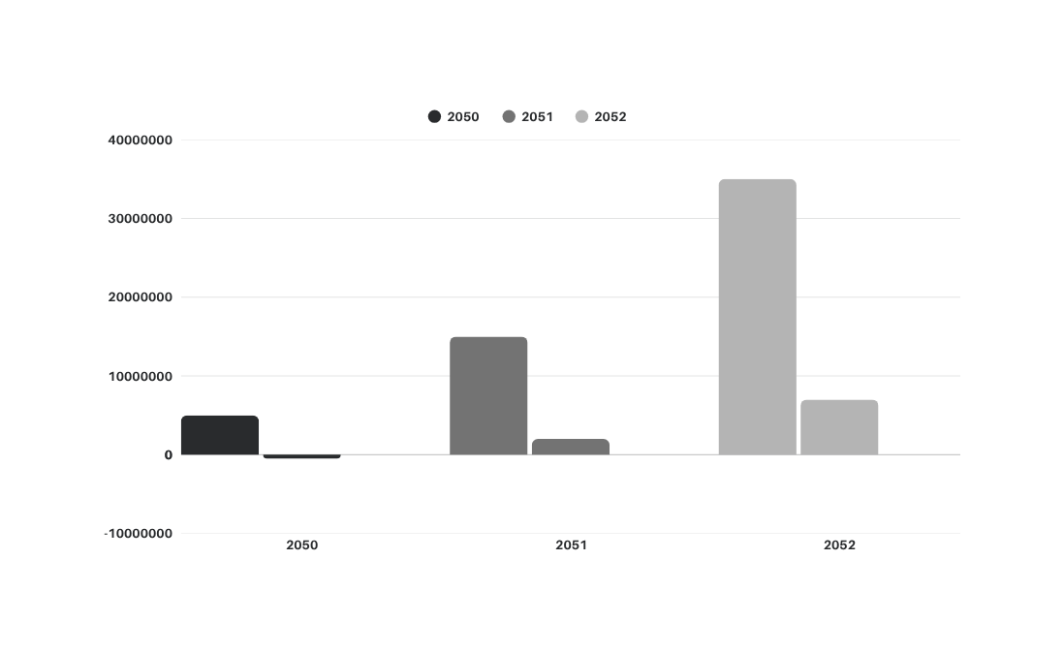
Milestones
TRACTION
Prototype completed (Q1 2050) — tested in Studio Showde & 123 Anywhere St. Any City
App beta 90% complete — integrates sensory controls + AI profiles
10K+ followers pre-launch across social media accounts (teaser campaign)
Partnerships with two local roasters & one green packaging supplier
Franchise-ready model by Year 3, with exportable tech Intellectual Property.
Financial Projections

Slide 11
COMPETITIVE
ANALYSIS
Why We Win: Combines tech precision + human mystery and Emotionally resonant, socially viral, and future-ready.
Brand
Experience
Type
Tech
Integration
Differentiator
Arrowai | Minimalist | Low | Focus on design aesthetic
Borcelle | Luxury | Medium | Quality beans
Platypus | Experiential + Sensory | High | Mystery, AI personalization, sensory OS
Salford | Mass | Medium | Convenience
Wardiere | Automated | High | Efficiency, but no emotional appeal

Slide 12
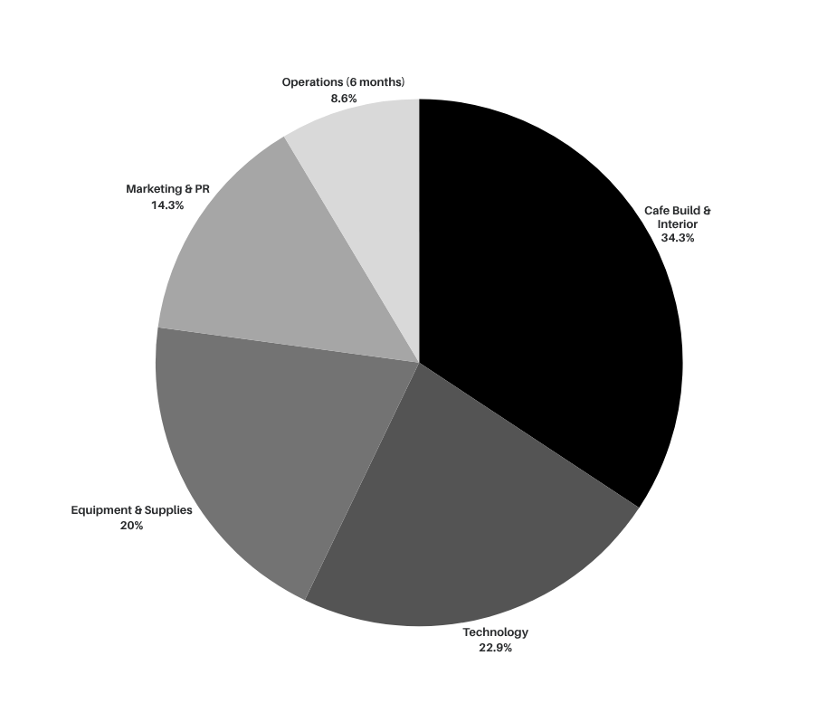
FUNDING
REQUEST
Invest in the café of the future — where the hand you don’t see shapes the experience you’ll never forget.
Investor Offer
15% equity stake + early option in regional expansion and licensing rights.
Ask
₱3.5M seed investment for prototype expansion and first flagship store.

Slide 13

JOIN US IN BREWING SOMETHING UNFORGETTABLE.
LET’S TALK
THE HAND IS WAITING!
Let’s redefine how people pause, feel, and connect in a digital world. Your investment fuels the next generation of experiential cafés — where AI meets artistry, and every cup tells a story.
hello@reallygreatsite.com / www.reallygreatsite.com / +123-456-7890 / @reallygreatsite

